Slide 1
Auxier, B., & Golbeck, J. (2017, September) The President on Twitter: A Characterization Study of @realDonaldTrump In International Conference on Social Informatics (pp. 377-390). Springer, Cham
Naga Vamsi Krishna Pabbisetty
2019-03-27

Slide 2
Donald Trump
45th president of the United States
Assumed office – 2017-01-20
President of Trump Organization from 1971
He owned the Miss Universe and Miss USA beauty pageants from 1996 to 2015
Net worth - $3.1 billion
https://en.wikipedia.org/wiki/Donald_Trump

Slide 3
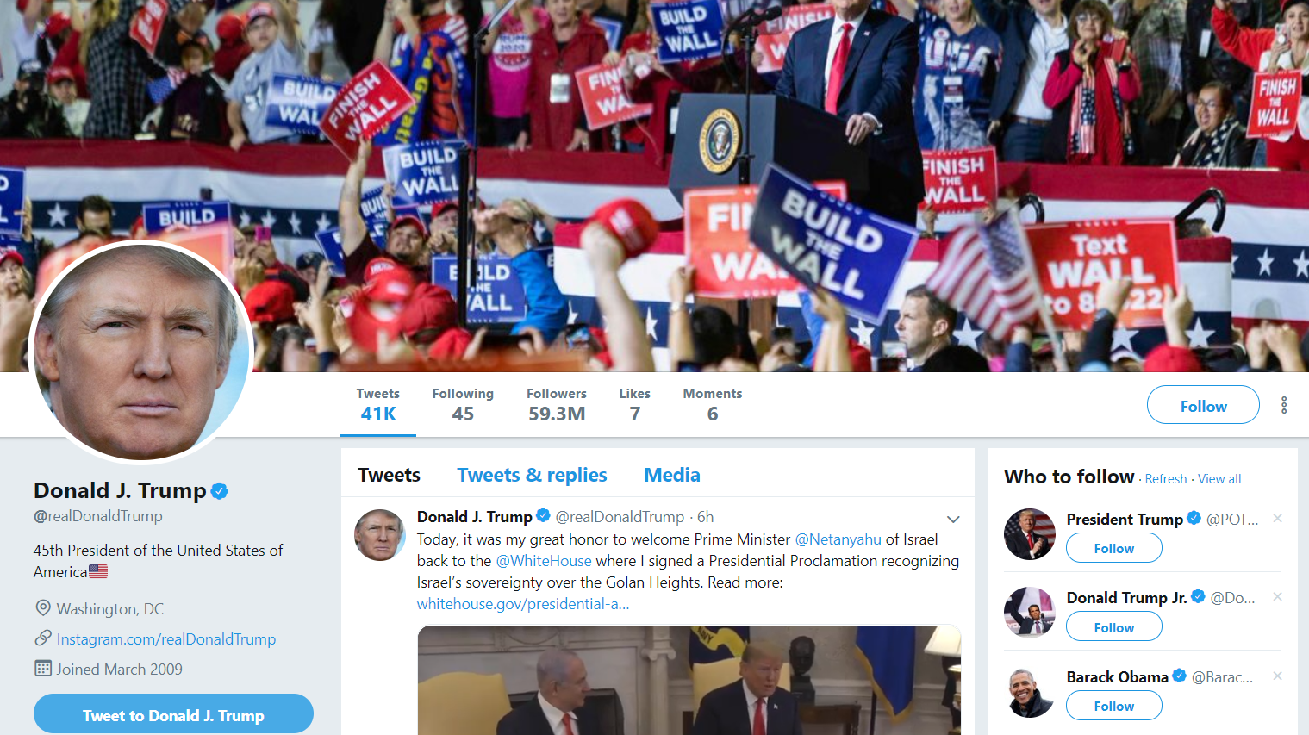
Twitter Page of Donald Trump
https://twitter.com/realDonaldTrump

Slide 4
Politicians on Twitter
As a way to gather voters and not to inspire or promote welfare
As a medium to grow popularity
Ex: 2016 US elections, campaign websites had no comment section
From observations, the active interactions took place between other politicians, journalists and activists

Slide 5
Type of analysis
Content based analysis
Mode used to distinguish – iPhone (staff) or Android (Trump)
Nuances between the tweets (language, interaction patterns and perception of the public)
Word vector approach was able to differentiate them with 87% accuracy

Slide 6
Data analysis and rating
Language of the tweets – appropriate for a President or not
20 americans (10 of each) were selected from a pool – self-described liberals and conservatives
Rating – Appropriate (score: 1), Neutral (score: 0) and Inappropriate (score: -1)
Rating is done based on Appropriateness of the tweet rather than their agreement to the tweet

Slide 7
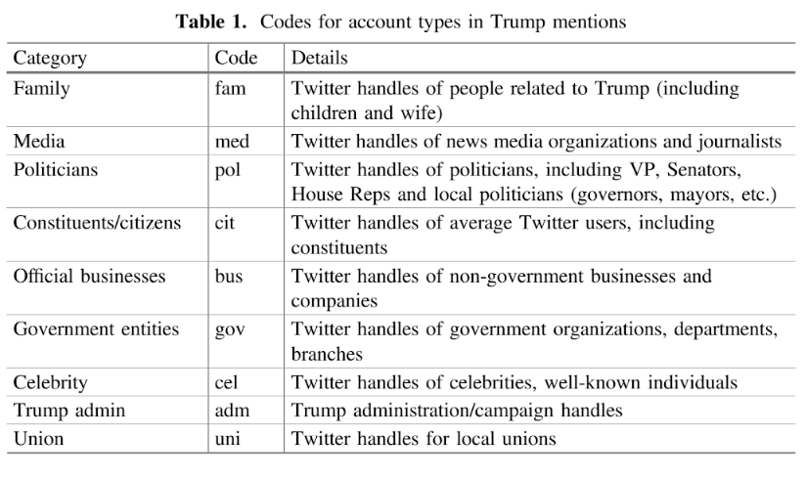
Mentions and retweets
DOI : 10.1007/978-3-319-67217-5_23

Slide 8
Content Characterization
Retweets
Android – 435+ retweets out of 550 retweets
iPhone – very few
Distribution – 429 retweets of citizens (81.2%) - rest were of media
Mentions
Android – 81% media and 10% politicians
iPhone – very diverse

Slide 9
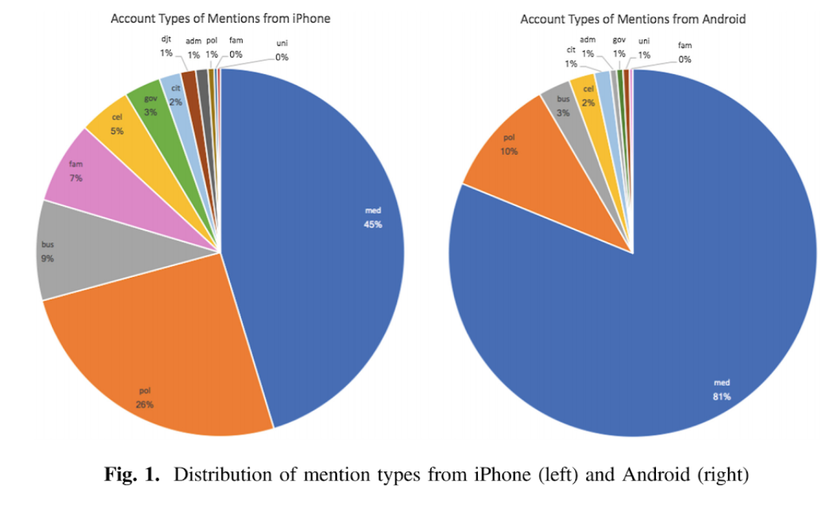
Distribution of mentions
DOI : 10.1007/978-3-319-67217-5_23

Slide 10
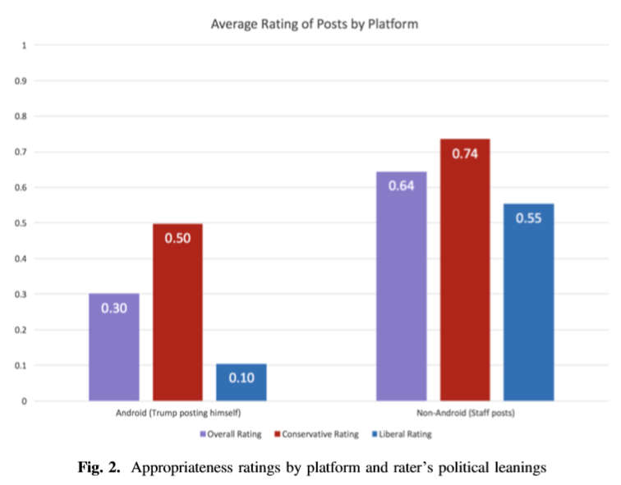
Appropriateness Ratings
DOI : 10.1007/978-3-319-67217-5_23

Slide 11
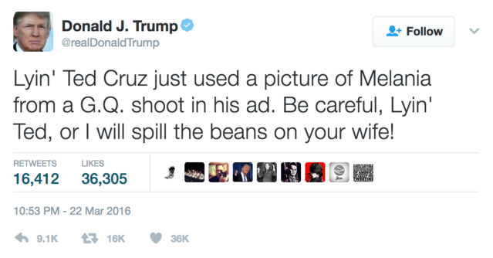
Trumps most inappropriate tweet
Received -0.9 over all rating (Only one conservative rated different)
DOI : 10.1007/978-3-319-67217-5_23

Slide 12
Ratings
Same rating by all 20 participants:
Neutral rating – 1297 tweets
Totally appropriate – 647 tweets (small number from Android but they were all campaign tweets)
53 tweets – Liberals unanimously deemed inappropriate
Average Rating
Liberals – 0.38
Conservatives – 0.64

Slide 13
Tweets deemed inappropriate unanimously
Taxpayers are paying a fortune for the use of Air Force One on the campaign trail by President Obama and Crooked Hillary. A total disgrace – (rating -1.6 (rest of them -1.5)
Really dumb @CheriJacobus. Begged my people for a job. Turned her down twice and she went hostile. Major loser, zero credibility!
@NBCNews is bad but Saturday Night Live is the worst of NBC. Not funny, cast is terrible, always a complete hit job. Really bad television!
Mitt Romney, who was one of the dumbest and worst candidates in the history of Republican politics, is now pushing me on tax returns. Dope!
DOI : 10.1007/978-3-319-67217-5_23

Slide 14
Tweets with major disagreements
Taxpayers are paying a fortune for the use of Air Force One on the campaign trail by President Obama and Crooked Hillary. A total disgrace!
Goofy Senator Elizabeth Warren @elizabethforma has done less in the U.S. Senate than practically any other senator. All talk, no action!
Watching John Kasich being interviewed - acting so innocent and like such a nice guy. Remember him in second debate, until I put him down.
What Barbara Res does not say is that she would call my company endlessly, and for years, trying to come back. I said no.
DOI : 10.1007/978-3-319-67217-5_23

Slide 15
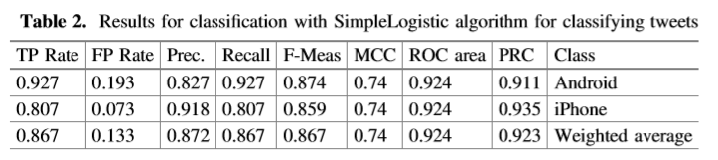
Prediction of Authorship
Each tweet as a word vector
Weka SimpleLogistic classiﬁer
Can predict the authorship of the tweet just with the language
86.7% accuracy
DOI : 10.1007/978-3-319-67217-5_23

Slide 16
“Appropriate” or “Inappropriate” classifier
Word Vector approach with the SimpleLogistic algorithm
Classifies the tweets as “Appropriate” or “Inappropriate
Inappropriate – average < 0
Appropriate – average > 0
87.3% accuracy

Slide 17
Conclusion
By knowing the platform used to tweet, author of a tweet can be found
From analysis, tweets that caused anger, created anxiety and negative emotion in people were tweeted by Trump
For someone in President position, Trump’s tweets were considered less appropriate
Predictive models to find tweet authorship and classification models to classify an inappropriate tweet can be developed using language makeup of the tweet
DOI : 10.1007/978-3-319-67217-5_23

Slide 18
Anderson, B. (2017). Tweeter-in-Chief: A Content Analysis of President Trump’s Tweeting Habits. Elon Journal of Undergraduate Research in Communications, 8(2), 36-47.

Slide 19
Data used for analysis
Assumed office - January 20, 2017
Tweets from the first 7 months after assuming office
1,272 tweets were collected from Twitonomy
Covers tweets during important political events and others
Ratings are given based on engagement levels by users

Slide 20
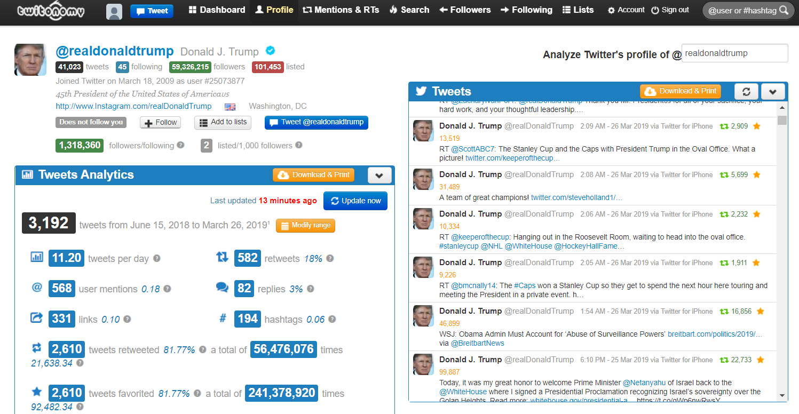
Twitonomy
http://www.twitonomy.com/profile.php?sn=realdonaldtrump

Slide 21
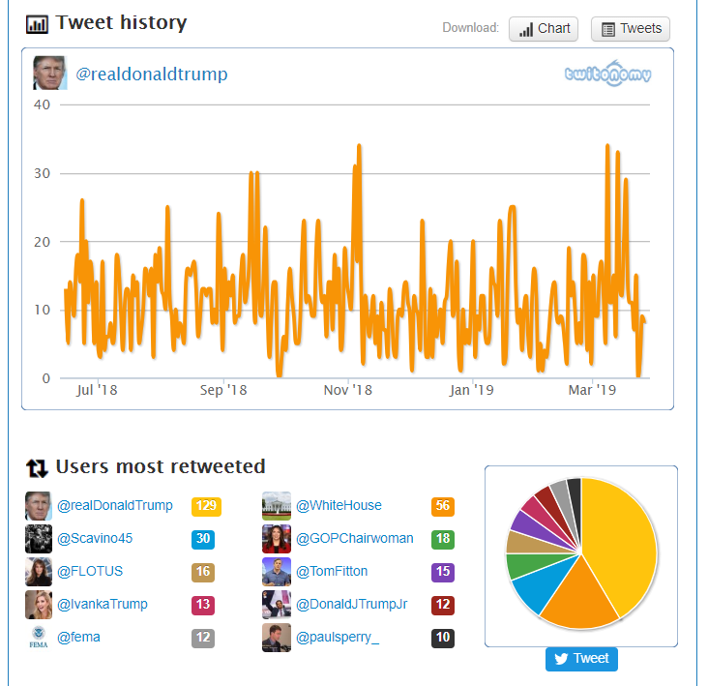
Tweet history and users most retweeted
http://www.twitonomy.com/profile.php?sn=realdonaldtrump

Slide 22
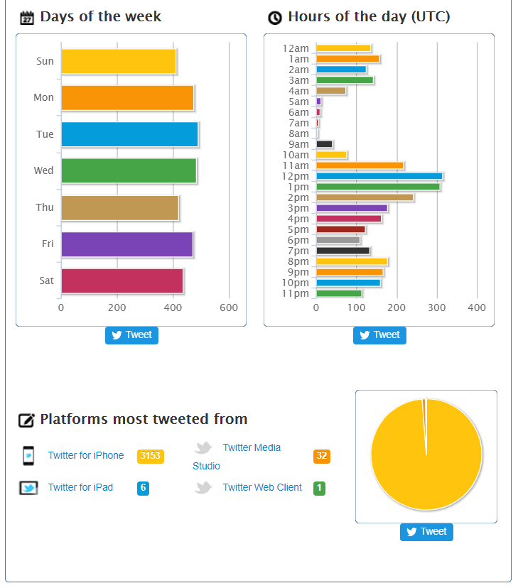
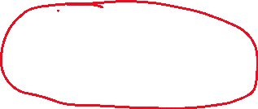
Platforms tweeted from
http://www.twitonomy.com/profile.php?sn=realdonaldtrump

Slide 23
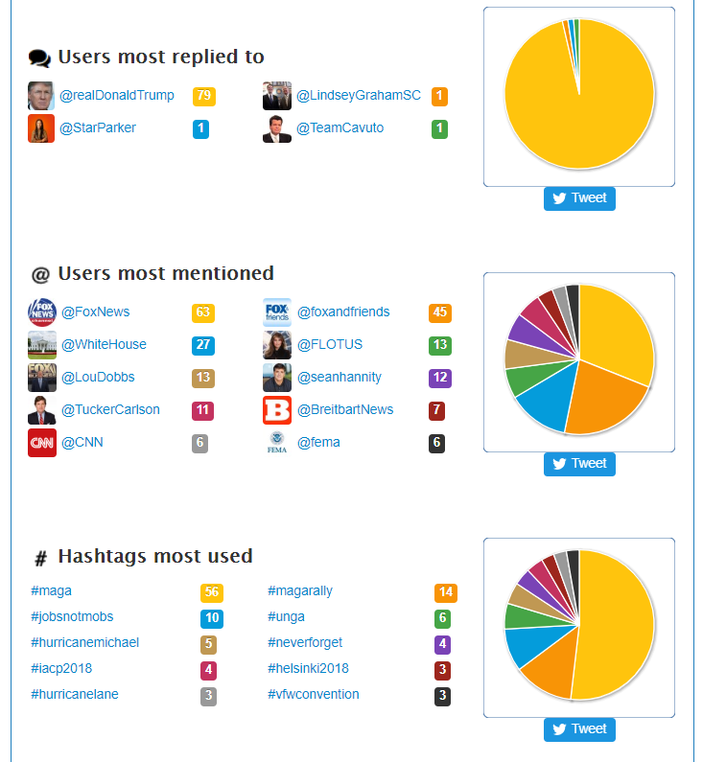
Users replied to mentioned and hashtags most used
http://www.twitonomy.com/profile.php?sn=realdonaldtrump

Slide 24
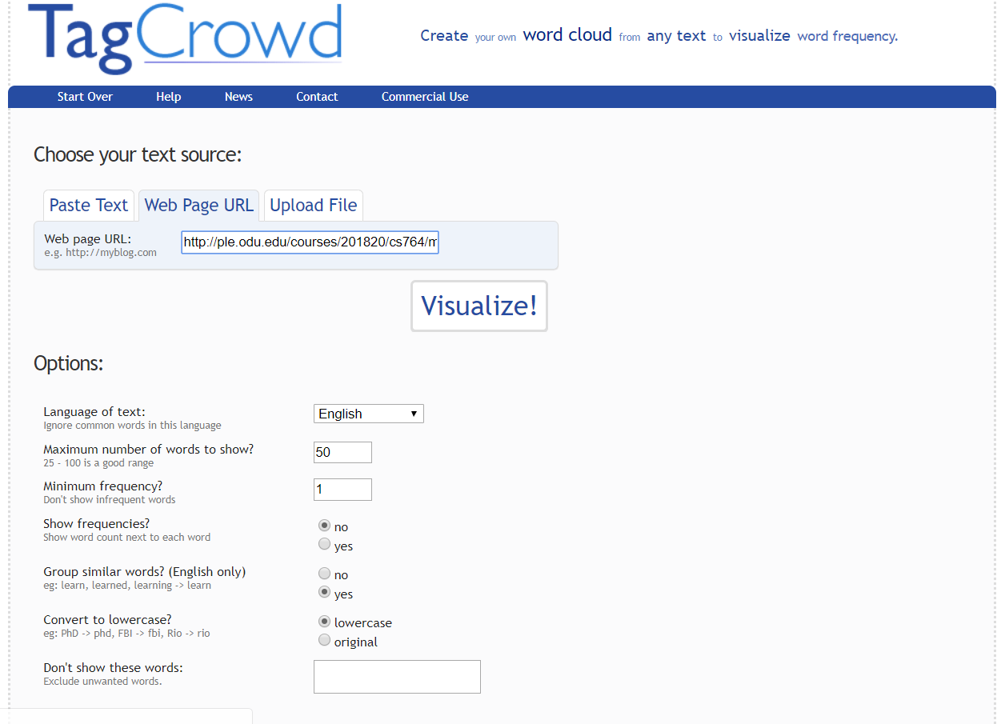
TagCrowd – a word cloud tool
https://tagcrowd.com/
INPUT URL - https://twitter.com/realDonaldTrump

Slide 25
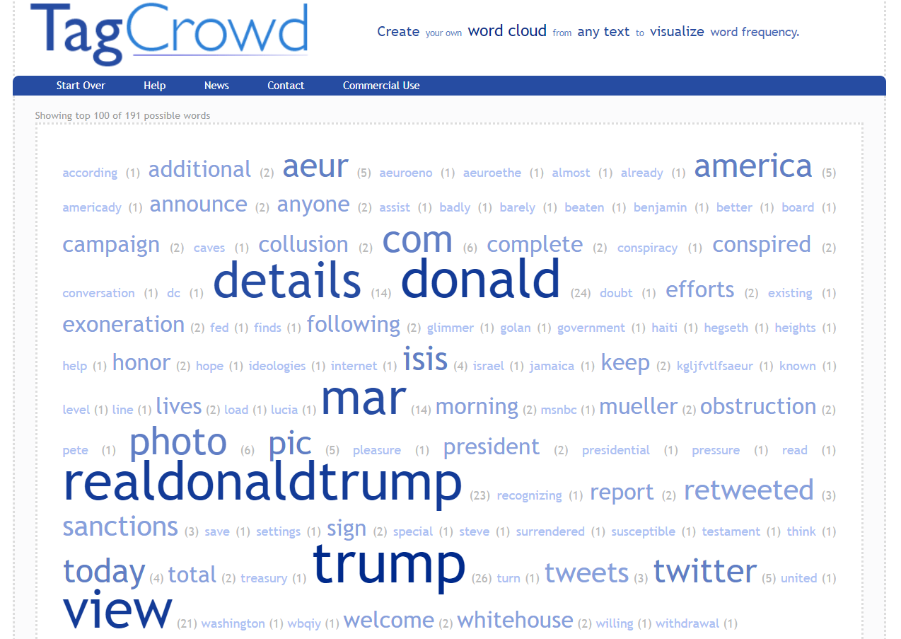
Analysing Twitter page of Donald Trump
https://tagcrowd.com/

Slide 26
Characterization of the tweets
Media criticism
Self-praise
Praising others
Personal attacks
Policy and other

Slide 27
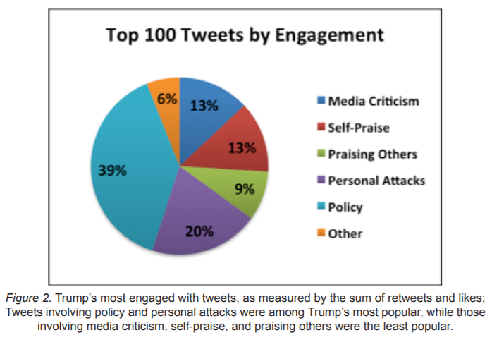
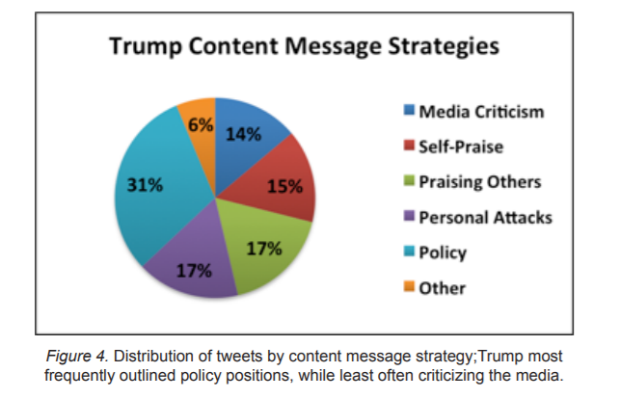
Distribution of tweets by engagement and content message strategies
https://www.elon.edu/u/academics/communications/journal/wp-content/uploads/sites/153/2017/12/04_TwitterInChief_Anderson.pdf

Slide 28
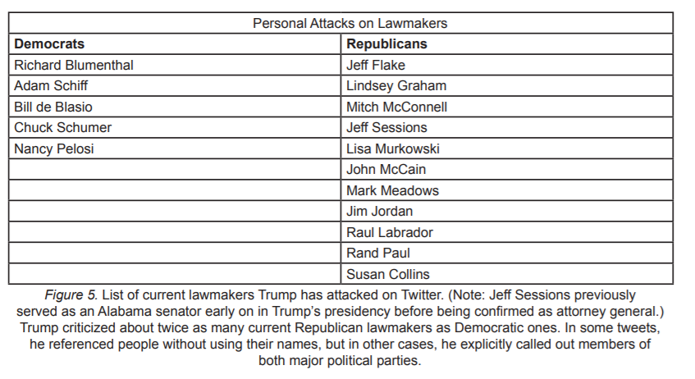
Democrats and Republicans alike
https://www.elon.edu/u/academics/communications/journal/wp-content/uploads/sites/153/2017/12/04_TwitterInChief_Anderson.pdf

Slide 29
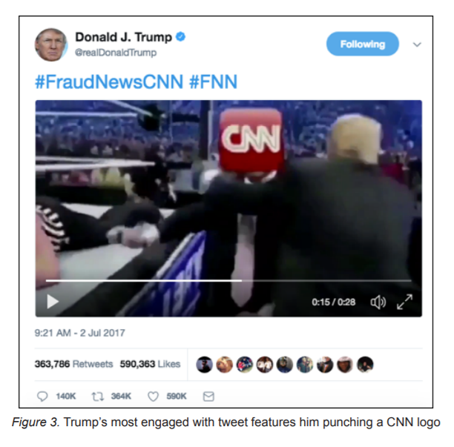
Most popular tweet by Donald Trump
https://www.elon.edu/u/academics/communications/journal/wp-content/uploads/sites/153/2017/12/04_TwitterInChief_Anderson.pdf

